Slide 1
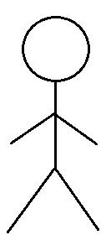
Use Case Diagram
United Tune Web Application
Use Case Diagram
Module: 01. User's Account
1.1 Register/ Sign In Account
1.2 Sign Account
1.3 Contact Tech Support
Customer
1.4 Pay for Services
1.5 Update Account
1.6 Delete Account
1.7 View Booking History
1.8 Rate Musicians

Slide 2
United Tune Web Application
Use Case Diagram
Module: 02. Musician Account
2.1 Register Account
2.2 Add Services
2.4 View Booking History
2.5 Define payment Method
Subscribed Musicians
2.6 Update Account Info
2.7 Close Account
2.8 Customers Rating

Slide 3
United Tune Web Application
Use Case Diagram
Module: 03. Admin Module
3.1 Manage Customers
3.2 Manage Musicians
Lead Engineer
IT Support
3.6 Manage Location Services
Sr Manager

